Slide 1



UNIT 5; Healthy and green
In shape

Slide 2



Slide 3
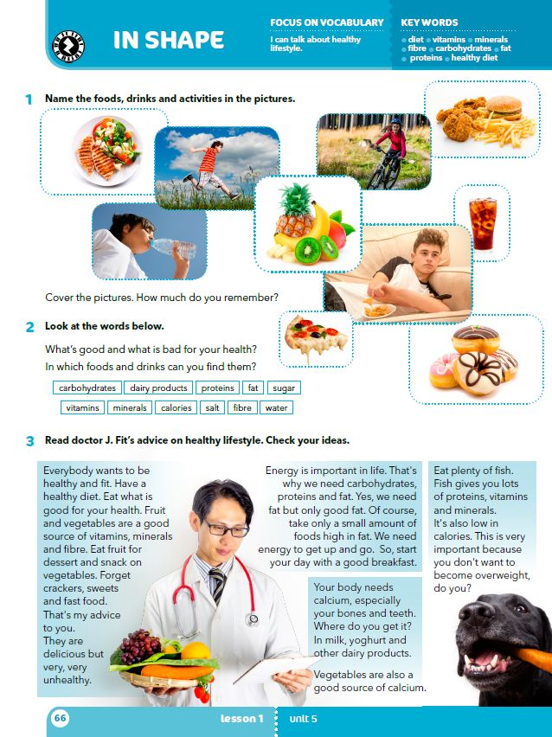
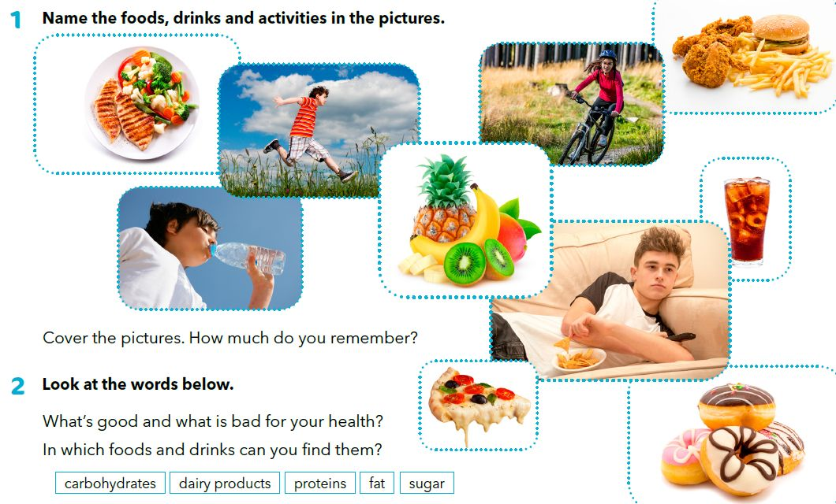
Think about what you eat and do every day, and make a list of six things you usually eat in a week, and six activities you do to keep in shape.

Slide 4

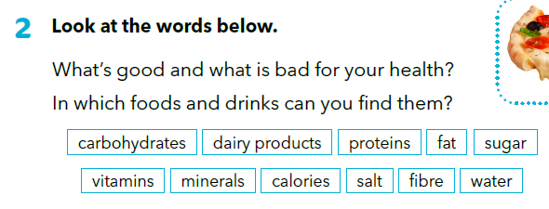
carbohydrates
dairy products
fibre
ugljikohidrati
mliječni proizvodi
vlakna

Slide 5
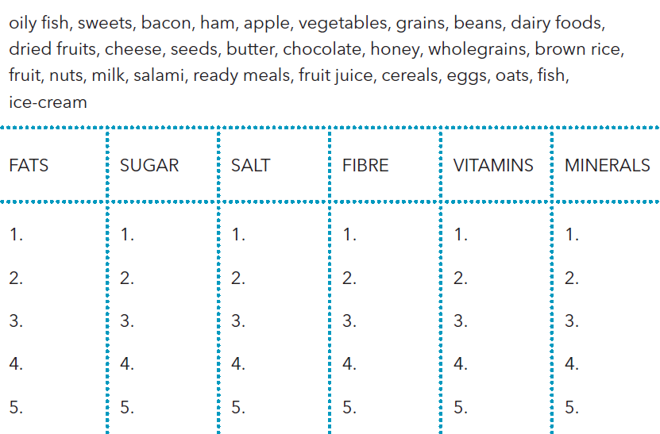
Sort out the words
oily fish
nuts
seeds
butter
milk
chocolate
sweets
honey
fruit juice
ice-cream
salami
bacon
ham
ready meals
cheese
oats
wholegrains
apple
brown rice
cereals
fruit
vegetables
grains
dairy foods
eggs
beans
nuts
dried fruits
fish
dairy foods

Slide 6
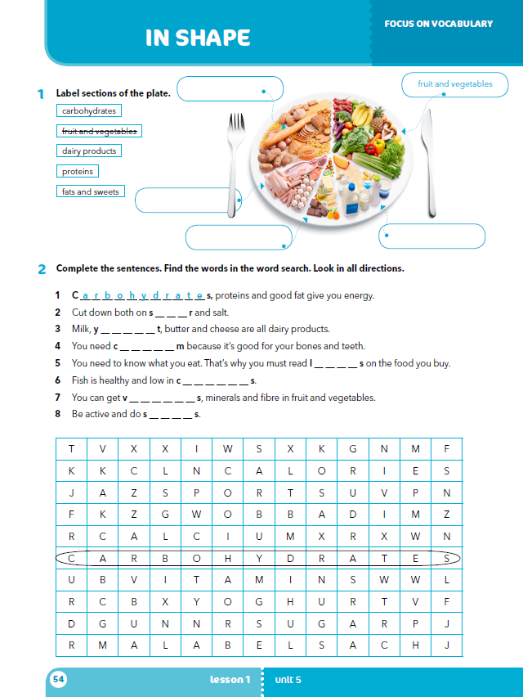
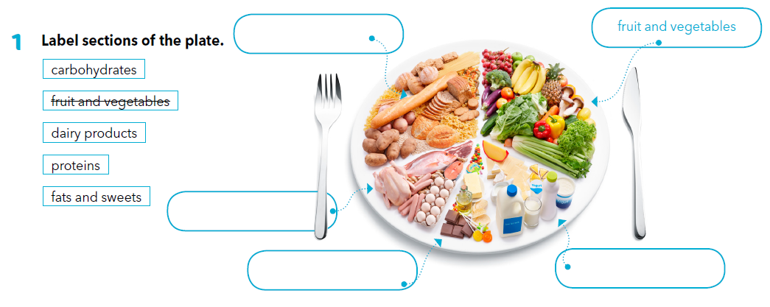
Workbook, p. 54
carbohydrates
proteins
fats and sweets
dairy products

Slide 7

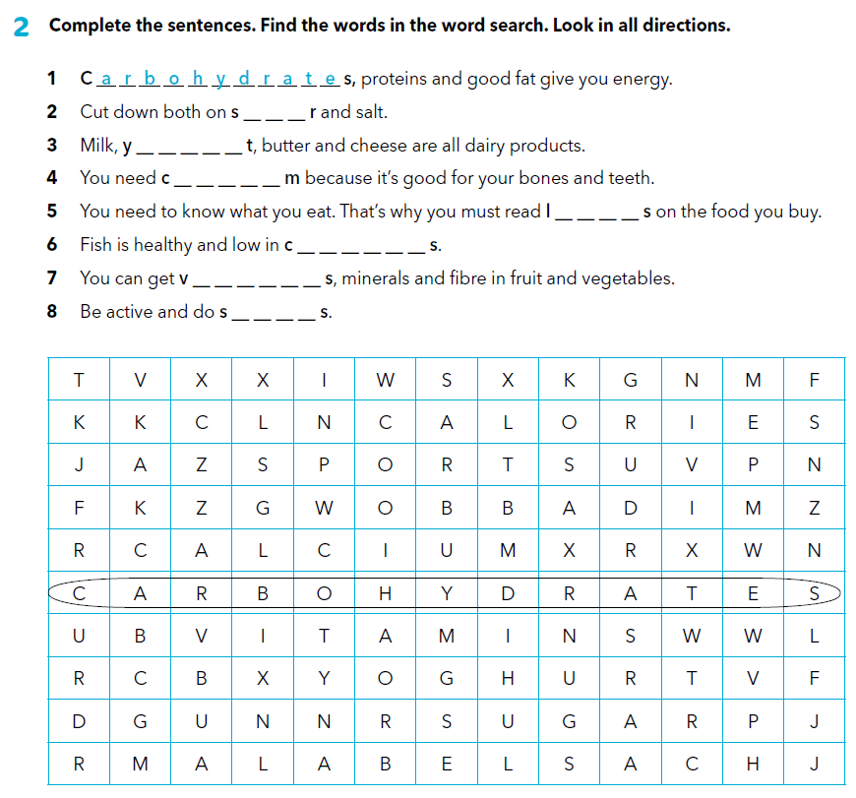
u g a
o g h u r
a l c i u
a b e l
a l o r i e
i t a m i n
p o r t
Practise: https://wordwall.net/play/917/463/988
https://wordwall.net/play/1094/320/269
https://wordwall.net/play/917/847/859

Slide 8

What is a diet?
Is it ok to have snacks? Is fat healthy?
Why is fish good for us?

Slide 9
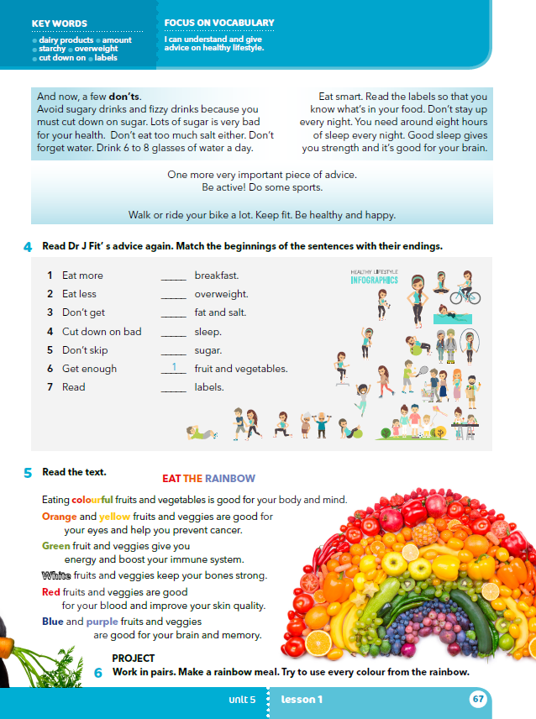
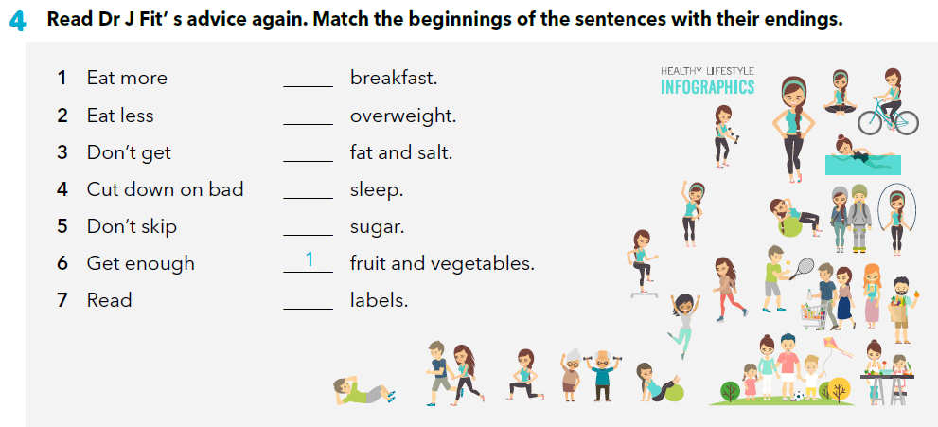
5
3
2
6
4
7
Practise again: https://wordwall.net/play/1094/283/596

Slide 10
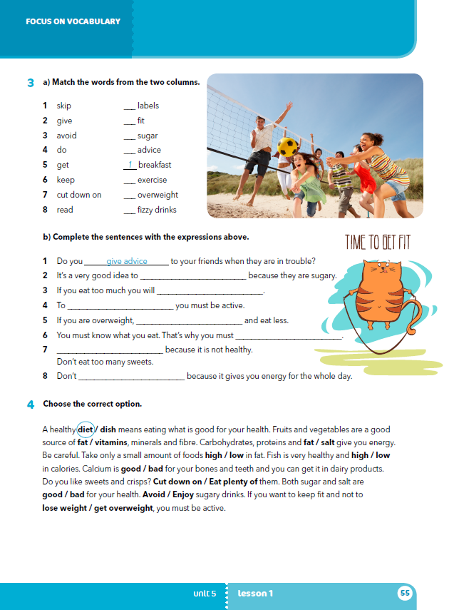
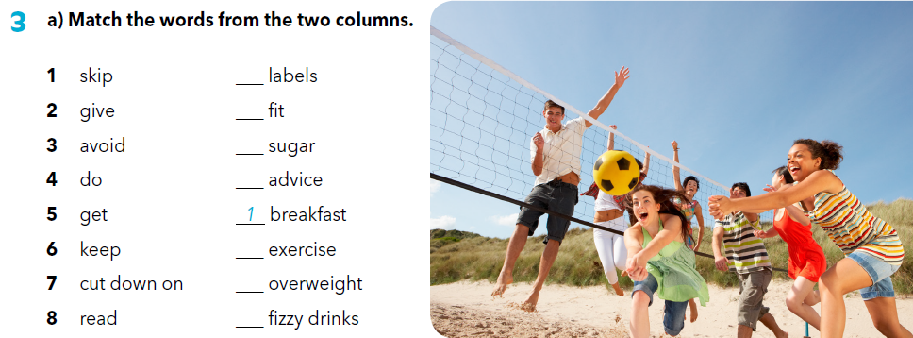
What is a diet?
What does a healthy diet look like?
Which food is known for having a lot of fibres/vitamins/minerals…?
What can be a healthy snack?
Workbook, p. 55
8
6
7
2
4
5
3

Slide 11
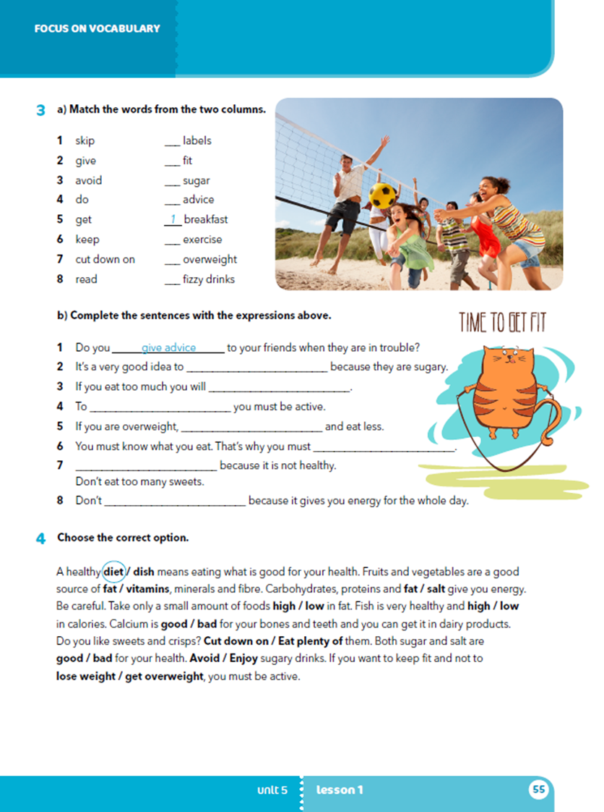
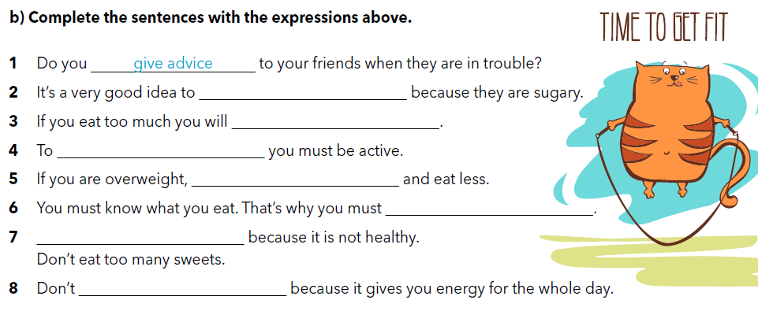
avoid fizzy drinks
get overweight
keep fit
do exercise
read labels
Cut down on sugar
skip breakfast

Slide 12
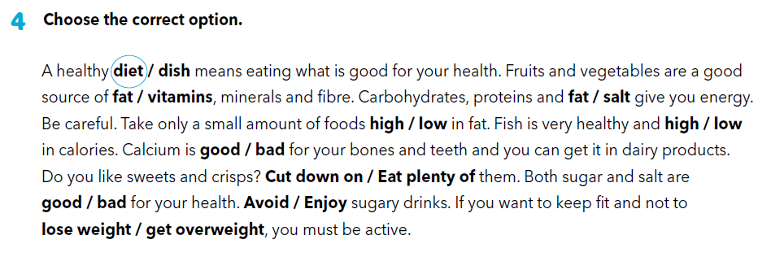


Slide 13

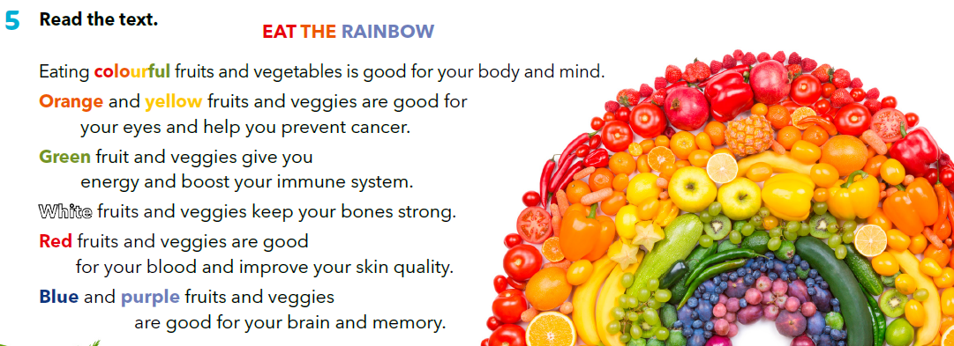
Zapiši u svoju bilježnicu barem po dvije namirnice sljedećih boja: žute, crvene, plave, zelene.

Slide 14

Name at least 4 people from your class who like to eat: a) ice-crem,
b) broccoli,
c) chocolate,
d) cheese.

Slide 15

LEARN MORE
https://www.e-sfera.hr/dodatni-digitalni-sadrzaji/d7e84dfd-3822-422b-8f92-996394c1353a/
We are what we eat

